Slide 1
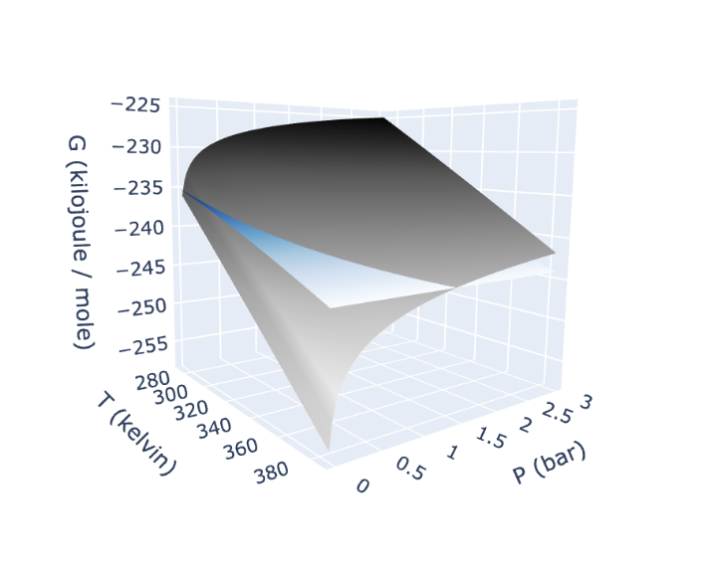
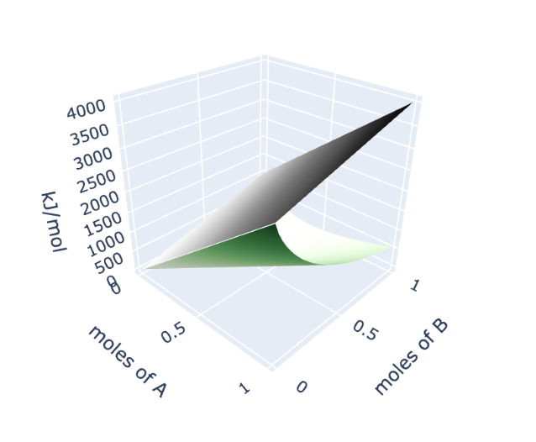
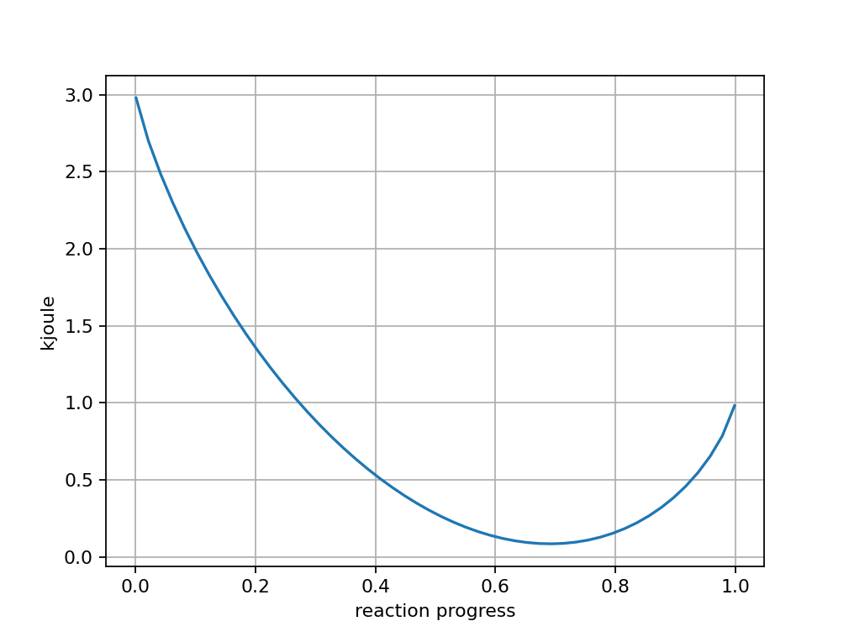
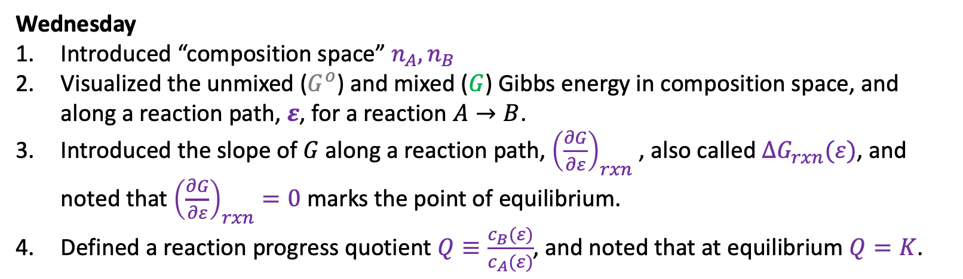


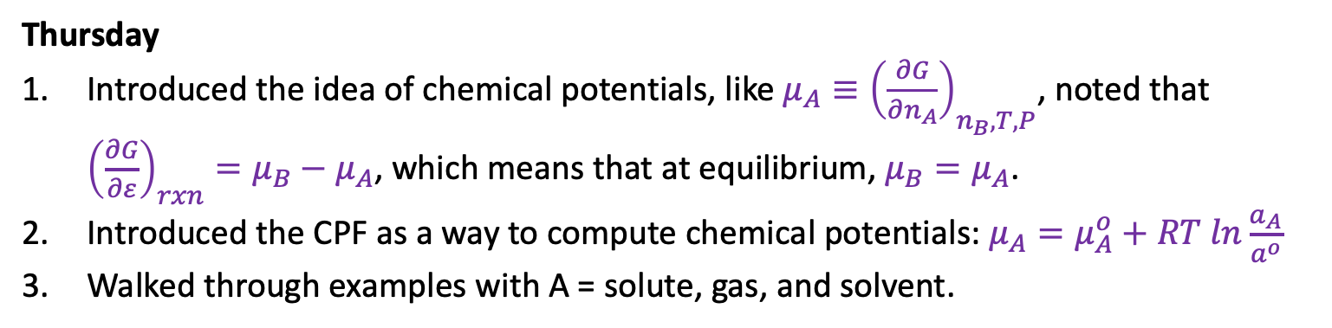
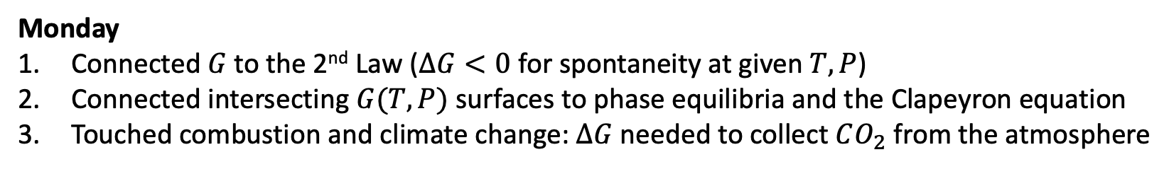
Recap of the week
Monday
Connected $G$to the 2nd Law ($∆G<0$ for spontaneity at given $T,P$)
Connected intersecting $G(T,P)$ surfaces to phase equilibria and the Clapeyron equation
Touched combustion and climate change: $∆G$ needed to collect $CO_{2}$ from the atmosphere
Gas
Wednesday
Introduced “composition space” $n_{A},n_{B}$
Visualized the unmixed ($G^{o}$) and mixed ($G$) Gibbs energy in composition space, and along a reaction path, $ε$, for a reaction $A→B$.
Introduced the slope of $G$ along a reaction path, ${\left(\frac{∂G}{∂ε}\right)}_{rxn}$ , also called $∆G_{rxn}(ε)$, and noted that ${\left(\frac{∂G}{∂ε}\right)}_{rxn}=0$ marks the point of equilibrium.
Defined a reaction progress quotient $Q≡\frac{c_{B}(ε)}{c_{A}(ε)}$, and noted that at equilibrium $Q=K$.
Liquid
$$G^{o}$$
$$G$$
Thursday
Introduced the idea of chemical potentials, like $μ_{A}≡{\left(\frac{∂G}{∂n_{A}}\right)}_{n_{B}, T,P}$, noted that ${\left(\frac{∂G}{∂ε}\right)}_{rxn}=μ_{B}−μ_{A}$, which means that at equilibrium, $μ_{B}=μ_{A}$.
Introduced the CPF as a way to compute chemical potentials: $μ_{A}=μ_{A}^{o}+RT ln\frac{a_{A}}{a^{o}}$
Walked through examples with A = solute, gas, and solvent.

Slide 2
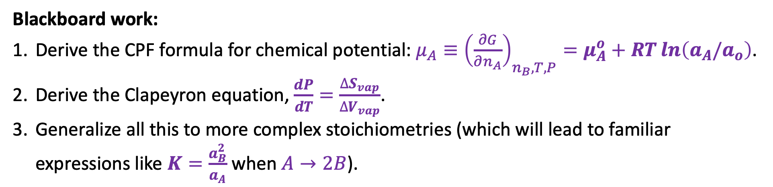
Today
Blackboard work:
Derive the CPF formula for chemical potential: $μ_{A}≡{\left(\frac{∂G}{∂n_{A}}\right)}_{n_{B}, T,P}=μ_{A}^{o}+RT\ln\left(a_{A}/a_{o}\right)$.
Derive the Clapeyron equation, $\frac{dP}{dT}=\frac{∆S_{vap}}{∆V_{vap}}$.
Generalize all this to more complex stoichiometries (which will lead to familiar expressions like $K=\frac{a_{B}^{2}}{a_{A}}$ when $A→2B$).

Slide 3

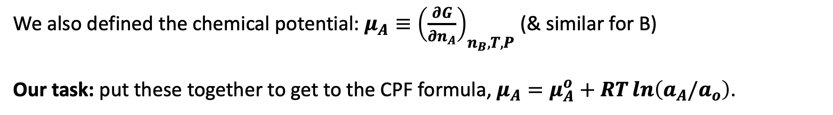





1. A derivation of the CPF formula focusing on solutes
Last week, thinking about the entropy of mixing (here, solutes with initial concentration $c_{o}$),
$$n_{A}$$
$$c_{A,f}=a_{A}$$
$$n_{B}$$
$$c_{A,f}=a_{B}$$
$$c_{o}$$
$$c_{o}$$
we said $∆S_{mix}=−n_{A}Rln\left(\frac{C_{A,f}}{C_{o}}\right)−n_{B}Rln\left(\frac{C_{B,f}}{C_{o}}\right)=−n_{tot}R\left[χ_{A}ln\left(χ_{A}\right)+χ_{B}ln\left(χ_{B}\right)\right]$
This week, we said $G=G^{o}+$ ${∆G}_{mix}= {n_{A}∆G}_{f}^{o}\left(A\right)+{n_{B}∆G}_{f}^{o}\left(B\right)−$ $T∆S_{mix}$
We also defined the chemical potential: $μ_{A}≡{\left(\frac{∂G}{∂n_{A}}\right)}_{n_{B}, T,P}$ (& similar for B)
Our task: put these together to get to the CPF formula, $μ_{A}=μ_{A}^{o}+RT\ln\left(a_{A}/a_{o}\right)$.

Slide 4
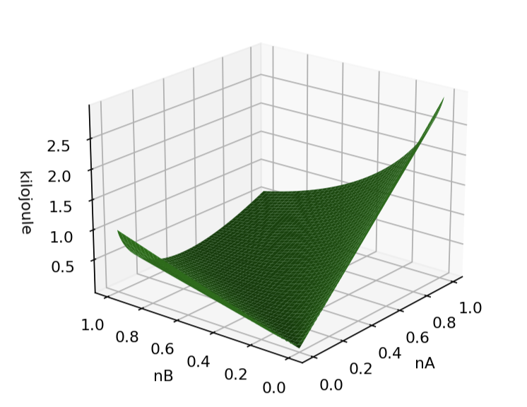
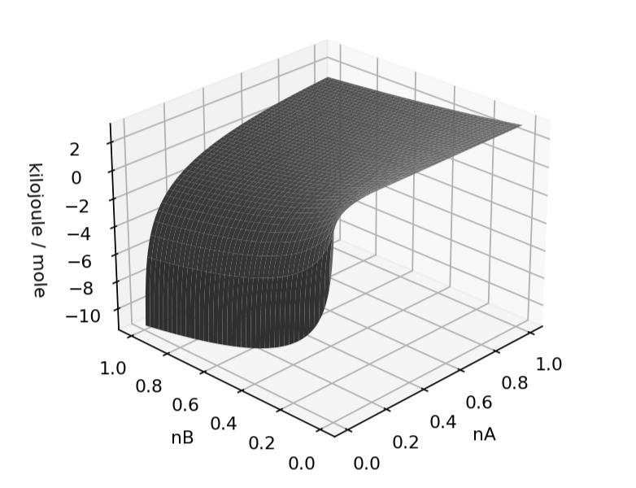
Visualizing CPF

Slide 5
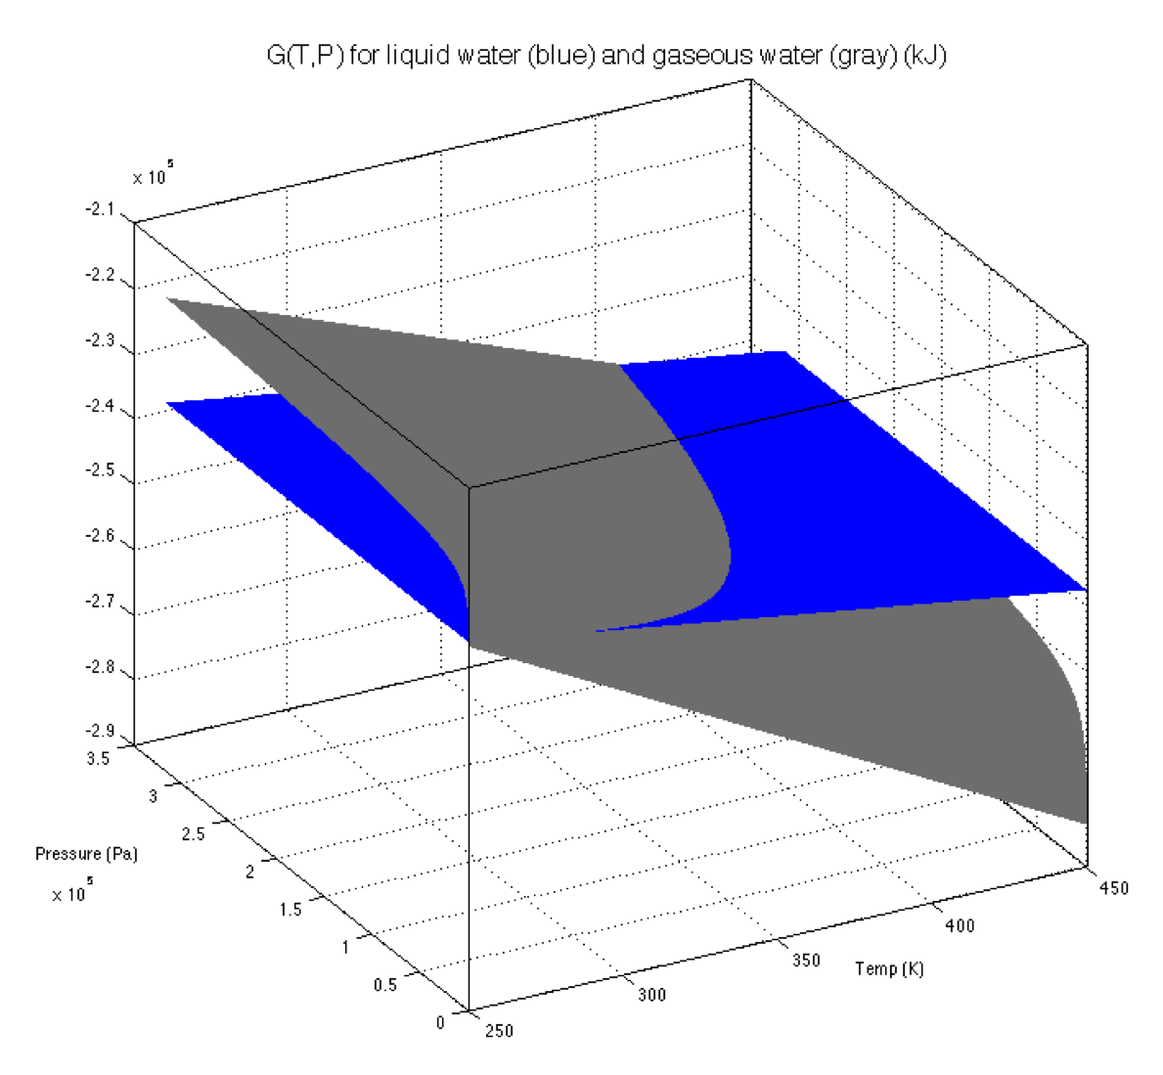
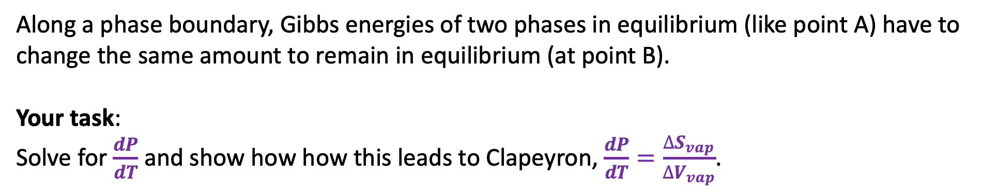
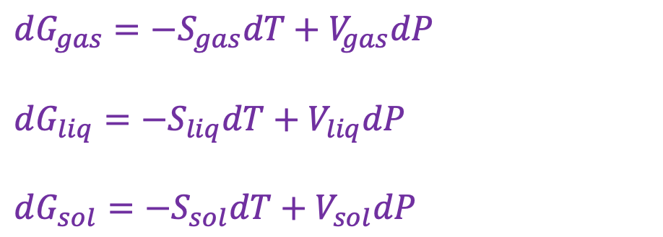
2. Deriving the Clapeyron equation
$dG_{gas}=−S_{gas}dT+V_{gas}dP$
$dG_{liq}=−S_{liq}dT+V_{liq}dP$
$dG_{sol}=−S_{sol}dT+V_{sol}dP$
B
A
Along a phase boundary, Gibbs energies of two phases in equilibrium (like point A) have to change the same amount to remain in equilibrium (at point B).
Your task:
Solve for $\frac{dP}{dT}$ and show how how this leads to Clapeyron, $\frac{dP}{dT}=\frac{∆S_{vap}}{∆V_{vap}}$.

Slide 6
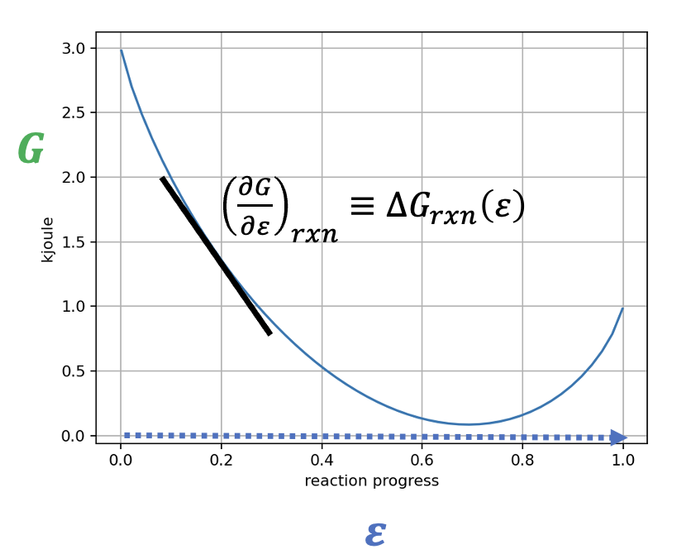
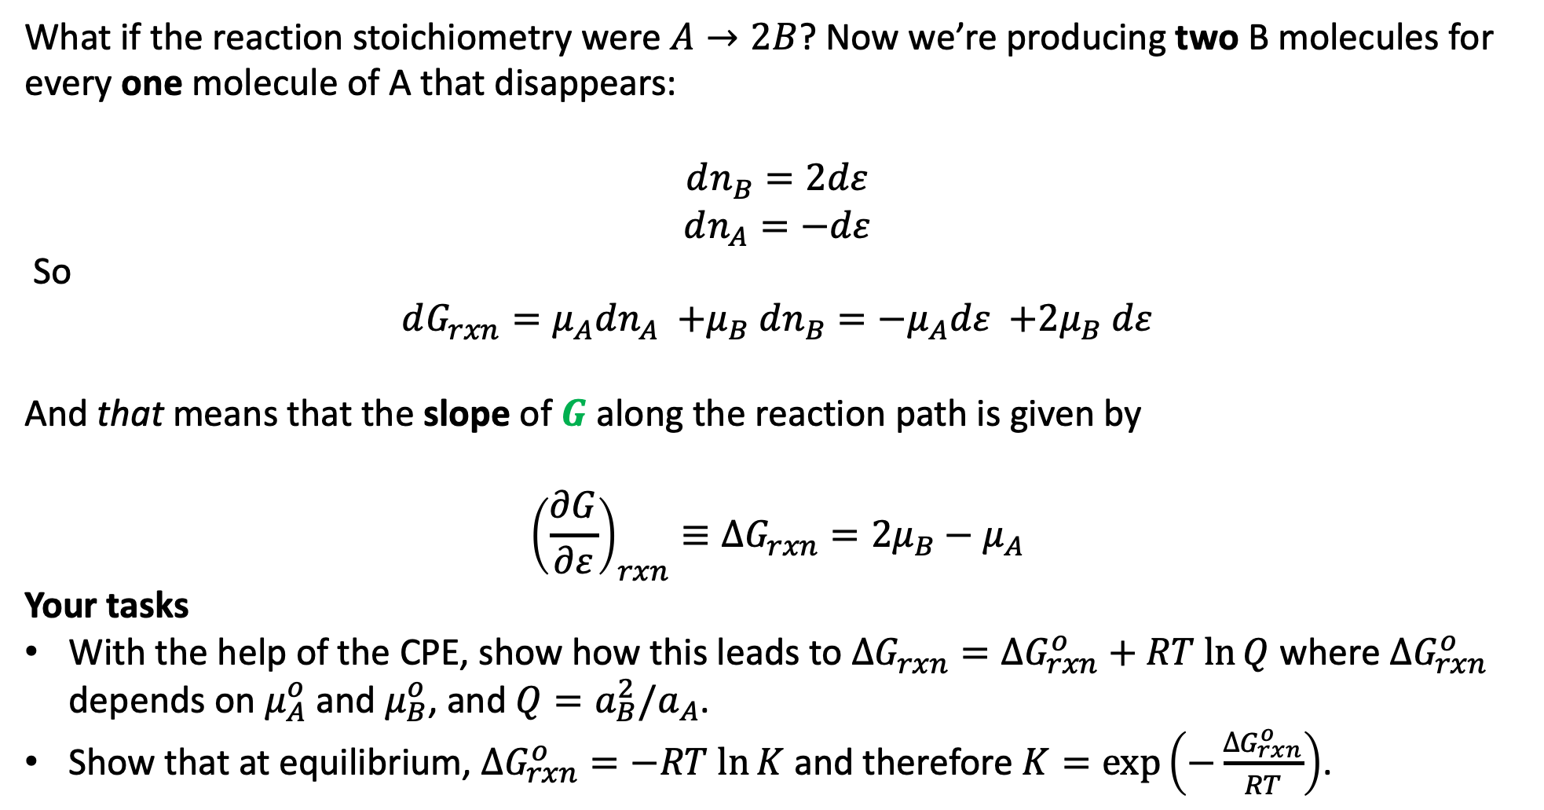
3. Generalizing the connection between $μ_{A}$, $μ_{B}$,${\left(\frac{∂G}{∂ε}\right)}_{rxn}≡∆G_{rxn}\left(ε\right)$, $Q$, and $K$
What if the reaction stoichiometry were $A→2B$? Now we’re producing two B molecules for every one molecule of A that disappears:
$$dn_{B}=2dε$$
$$dn_{A}=−dε$$
So
$$dG_{rxn}={μ_{A}dn_{A} {+μ}_{B}dn_{B}=−μ}_{A}dε {+2μ}_{B}dε$$
And that means that the slope of $G$ along the reaction path is given by
$${\left(\frac{∂G}{∂ε}\right)}_{rxn}≡∆G_{rxn}={2μ}_{B}−μ_{A}$$
Your tasks
With the help of the CPE, show how this leads to $∆G_{rxn}=∆G_{rxn}^{o}+RT ln⁡Q$ where $∆G_{rxn}^{o}$ depends on $μ_{A}^{o}$ and $μ_{B}^{o}$, and $Q={a_{B}^{2}/a}_{A}$.
Show that at equilibrium, $∆G_{rxn}^{o}=−RT ln⁡K$ and therefore $K=\exp\left(−\frac{∆G_{rxn}^{o}}{RT}\right)$.

Slide 7
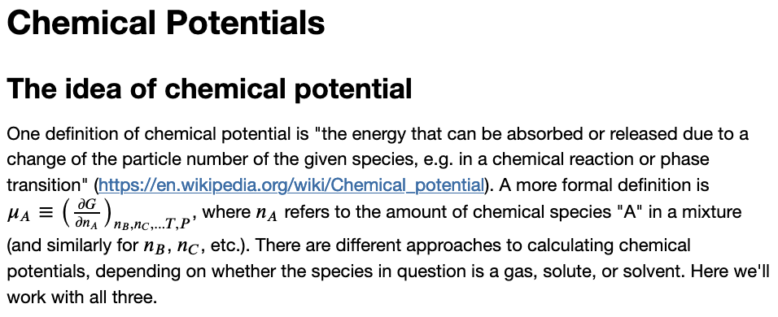
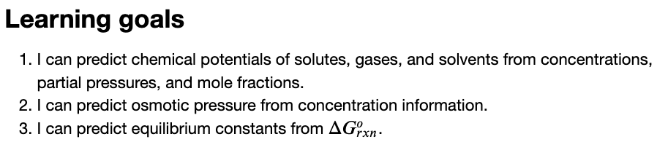
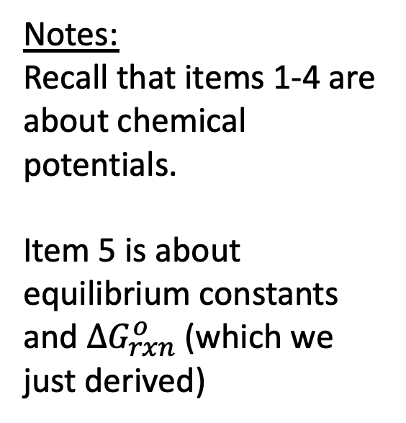
The CGI associated with this
Notes:
Recall that items 1-4 are about chemical potentials.
Item 5 is about equilibrium constants and $∆G_{rxn}^{o}$ (which we just derived)

